Slide 1

PROJECT-1
ONLINE VACATION BOOKING
PROJECT MEMBER:
A.SAI KIRAN
SUPER-15
#EDITION-1

Slide 2
CONTENTS
ABOUT PROJECT
EXISTING SYSTEM
OBJECTIVES AND GOALS
PROPOSED SYSTEM
HARDWARE REQUIREMENTS AND SOFTWARE REQUIREMENTS
RESULTS
FUTURE SCOPE AND ENHANCEMENT
CONCLUSION

Slide 3
ABOUT PROJECT
User-friendly Booking
Dynamic navigation web page
Increased profitability for Paradise vacation owners

Slide 4
EXISISTING SYSTEM
Inefficient management
Lack of customization
Lost revenue
Missed opportunities
Limited Accessibility

Slide 5
OBJECTIVE GOALS
Sustainability and Ethical Considerations
Communication and Connectivity
Improved time management
Enhanced customer satisfaction

Slide 6
PROPOSED SYSTEM
User-friendly interface
Data analytics for decision-making
Robust security measures

Slide 7
HARDWARE REQUIREMENTS
Hardware interfaces specifies the logical characteristics of each interface between the software product and the hardware components of the system. The following are some hardware requirements.
Processor : i3 or above
RAM : 1 GB or more.
Hard disk : 40 GB or more.
Monitor : Any Monitor.
Keyboard : Standard Keyboard.
Mouse : Two or Three Button Mouse.

Slide 8
SOFTWARE REQUIREMENTS
Software Requirements specifies the logical characteristics of each interface and software components of the system. The following are some software requirements
Operating system : windows family, linux.

Slide 9
IMPLEMENTATION
Below are the Technologies used:
HTML
CSS

Slide 10
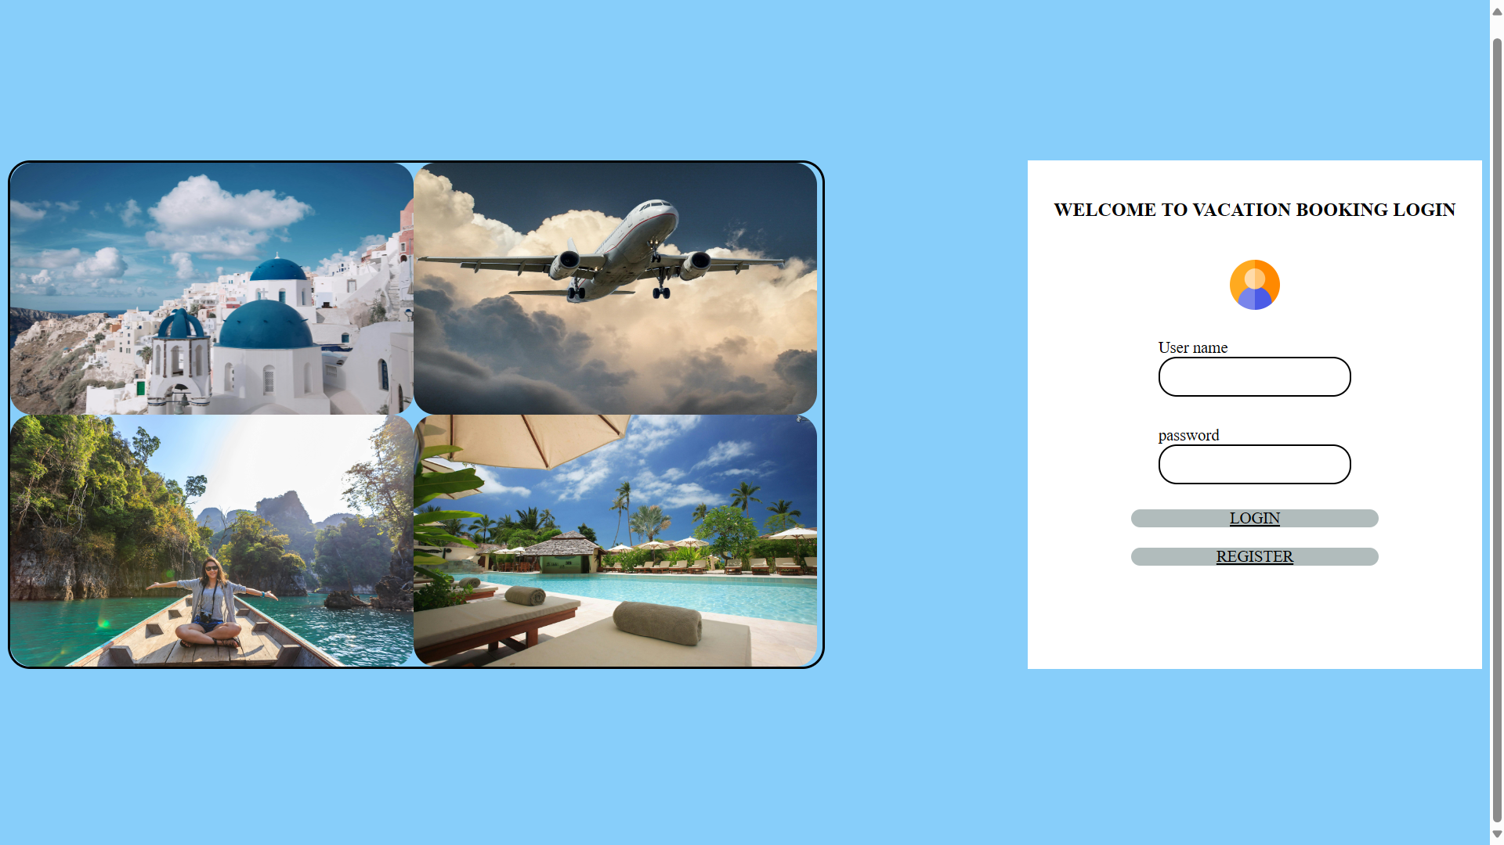
RESULTS

Slide 11
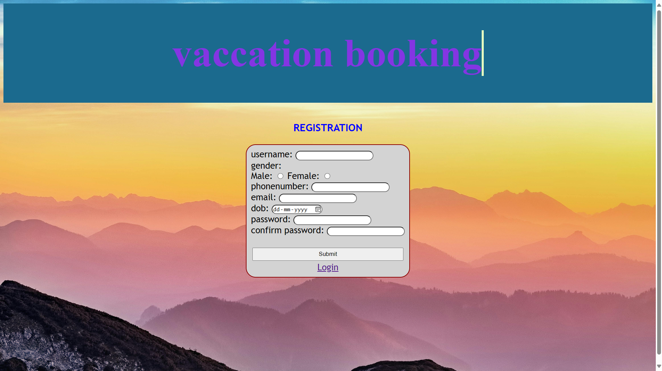

Slide 12
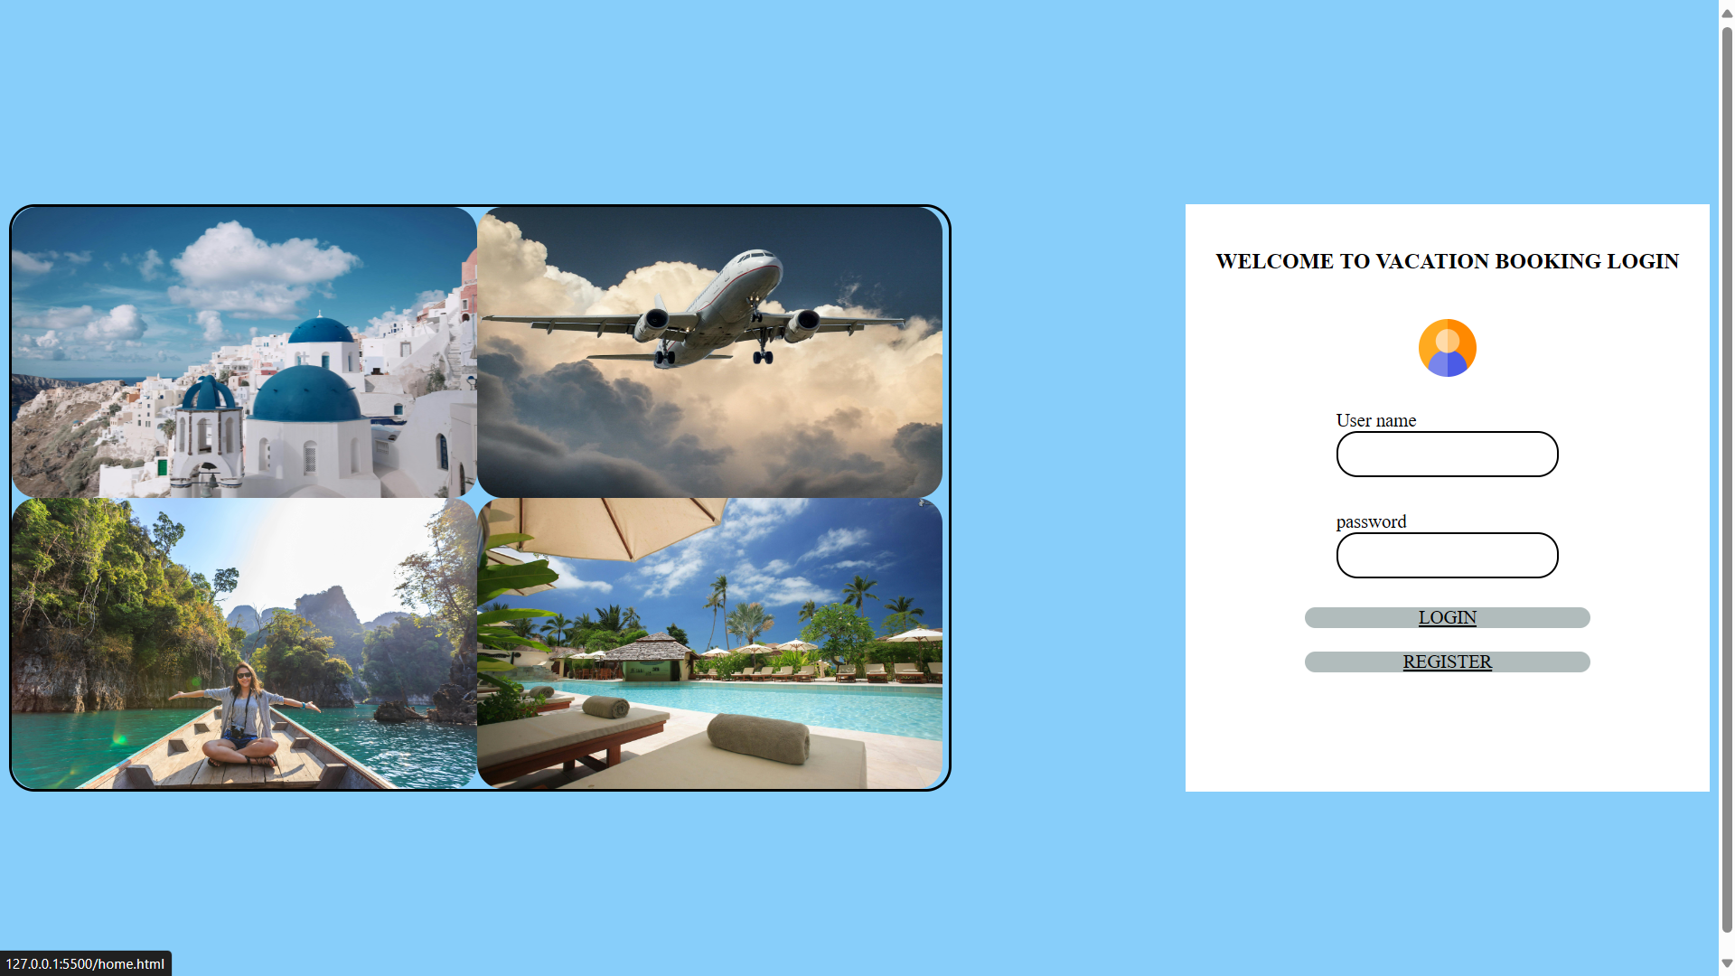

Slide 13
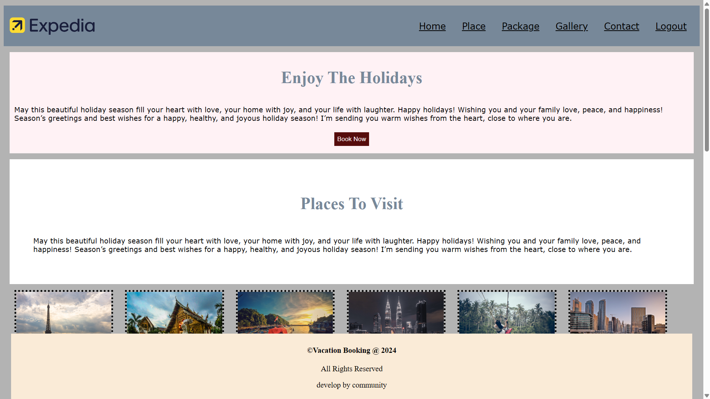

Slide 14
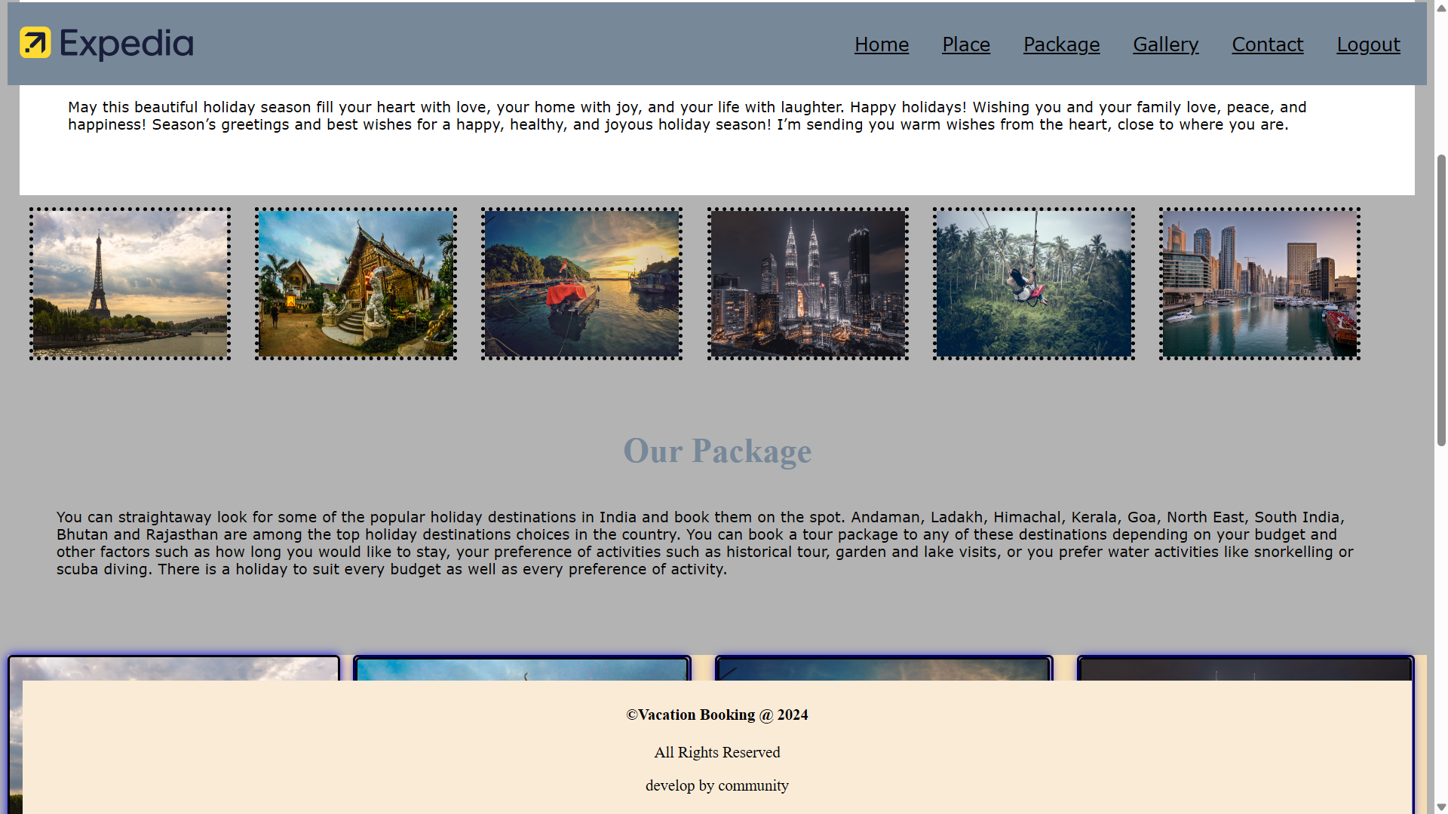

Slide 15
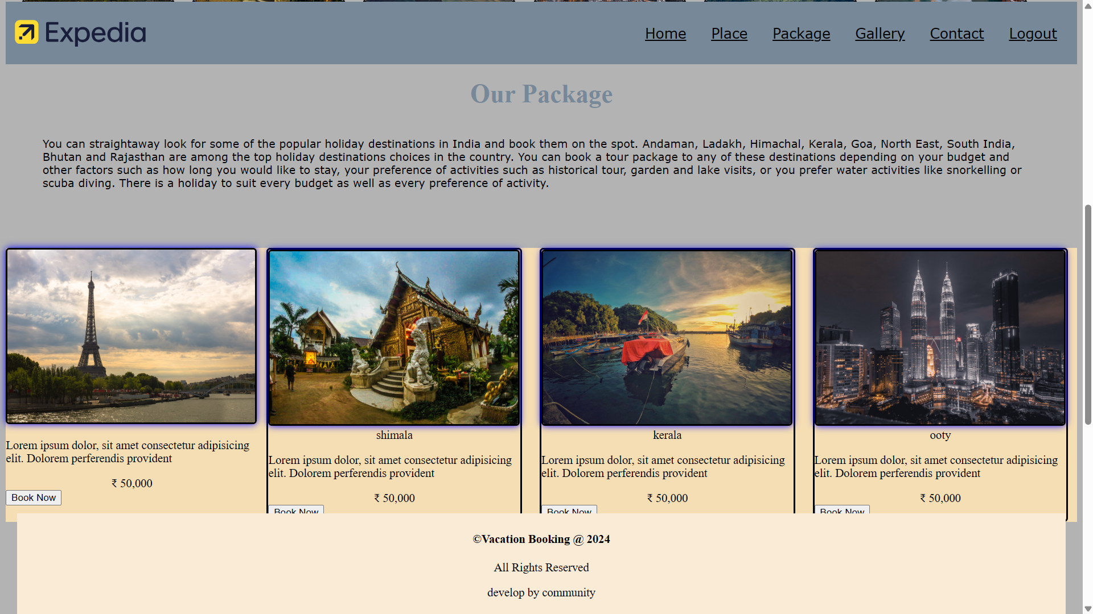

Slide 16
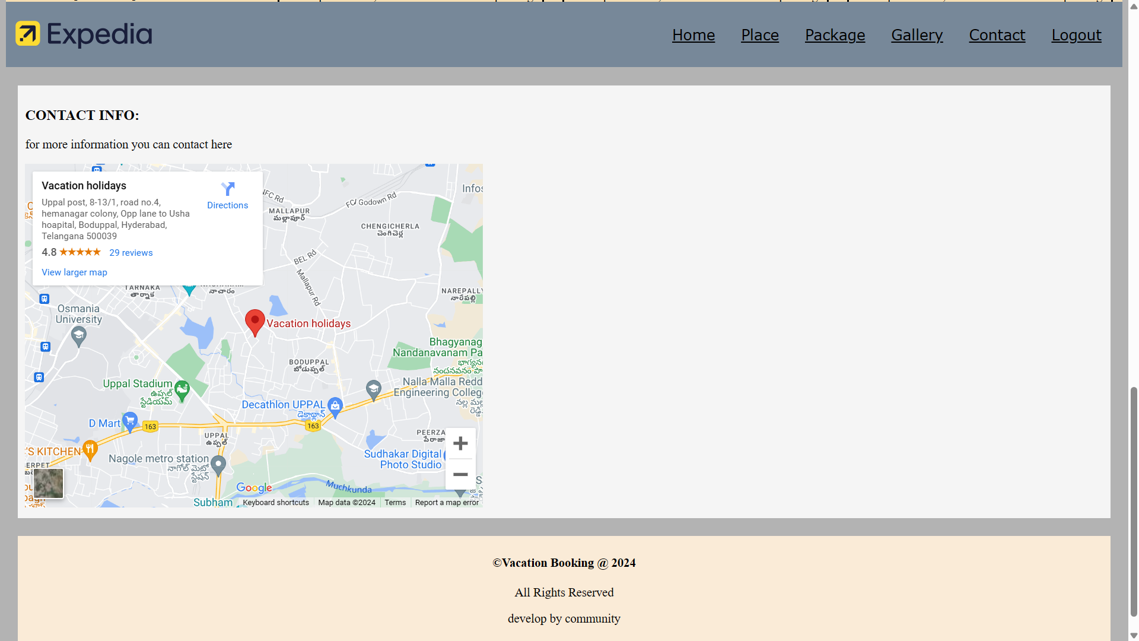

Slide 17
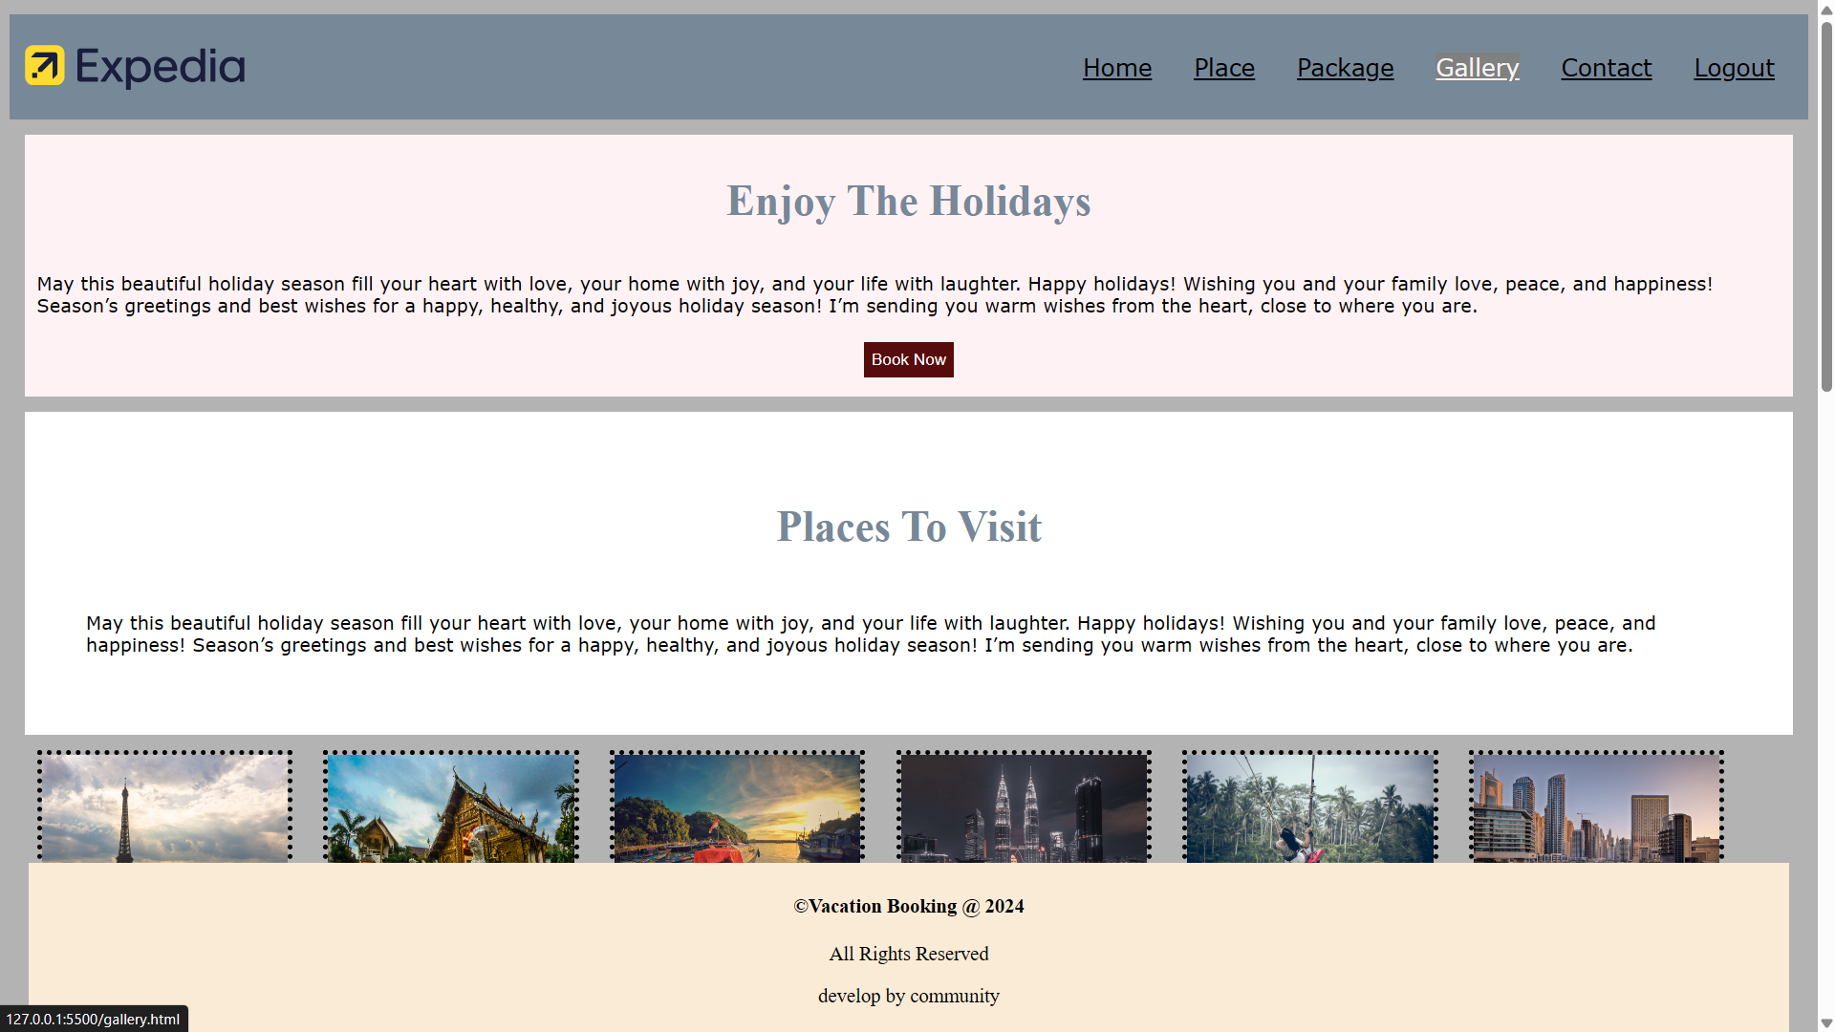

Slide 18
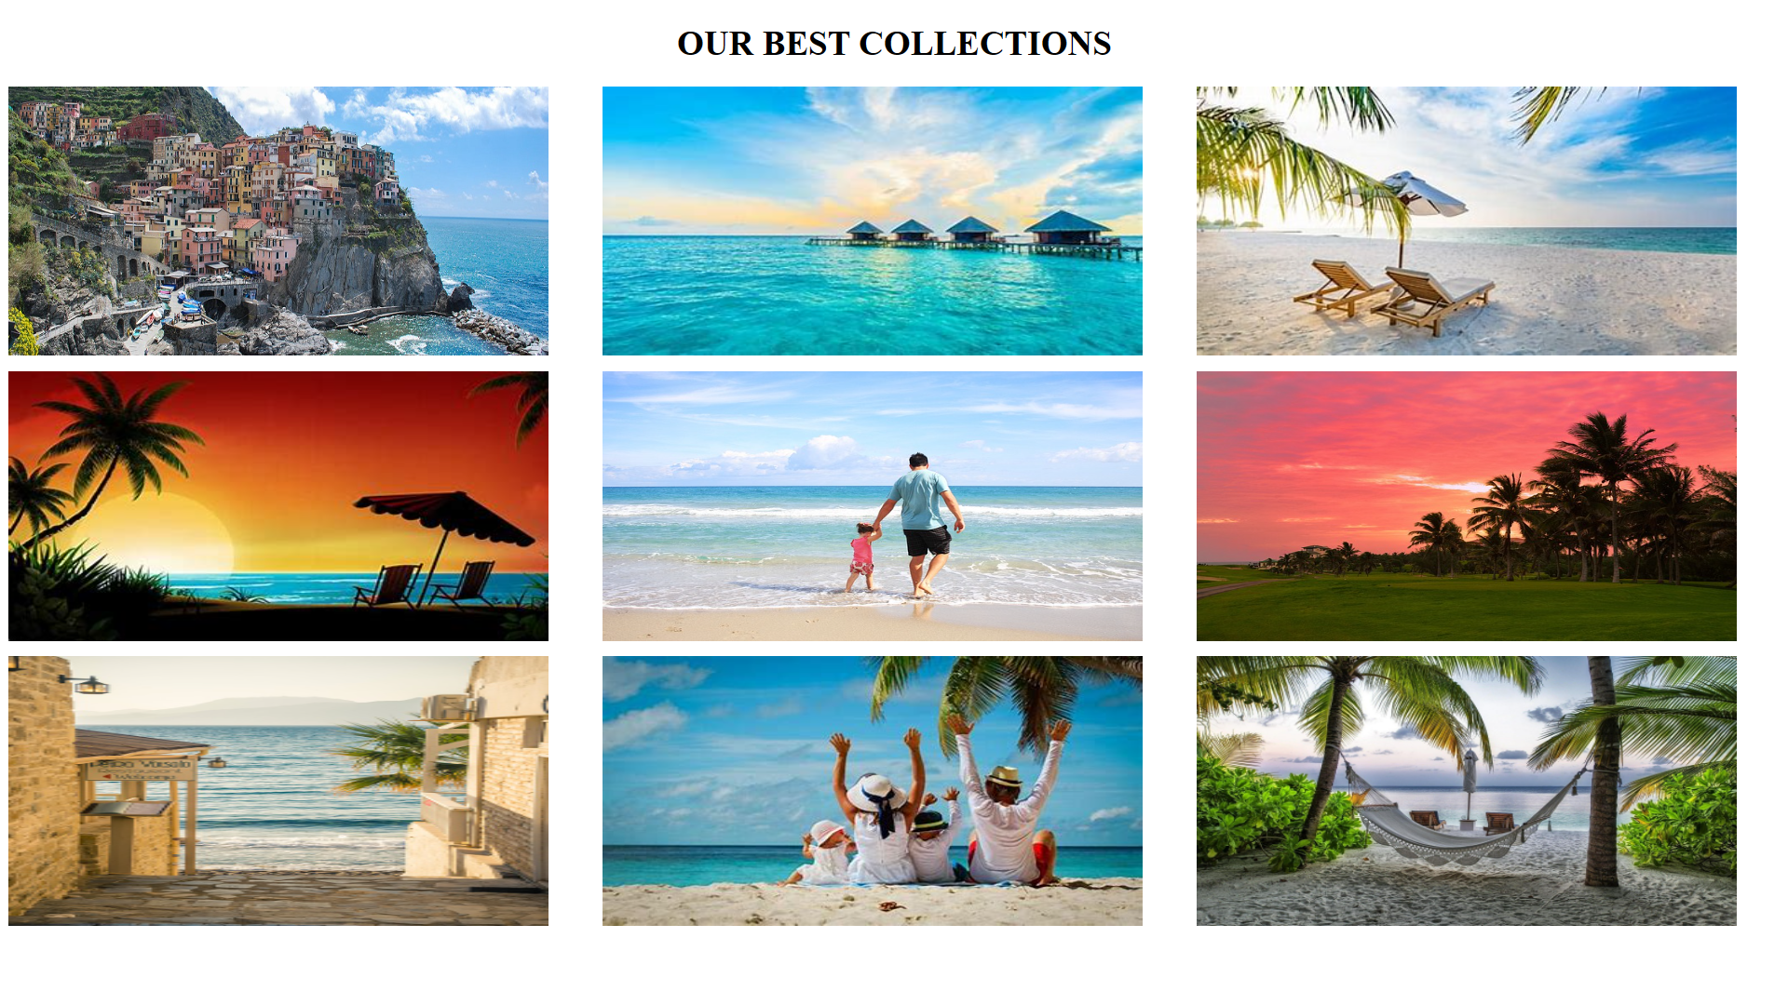

Slide 19
CONCLUSION
Our project successfully demonstrated the feasibility and efficiency of an online vacation booking system.
The system provides a user-friendly interface for customers to browse, compare, and book vacation packages.
Integration with various service providers ensures a wide range of options and competitive pricing.
Our vacation booking project is a step forward in revolutionizing the travel industry, providing customers with a seamless and enjoyable booking experience

Slide 20
FUTURE SCOPE AND ENHANCEMENT
Expansion: Incorporate more service providers to broaden the range of offerings.
Technological Enhancements: Implement AI-driven recommendations and chatbots for customer support.
Mobile Integration: Develop a mobile app to provide on-the-go booking capabilities.

Slide 21
THANK YOU

